Slide 1

Pointers & Pass by Value
Kevin Lin

Slide 2
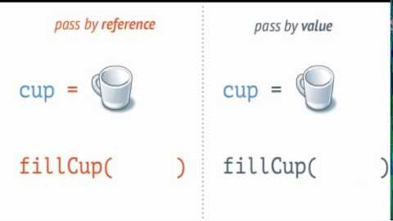
Why did the email not update in the last video?
Everything in go is pass by value
When updating the email for the person struct we are updating a copy of that
struct and not the original struct, this is called pass by value.

Slide 3
Simplified RAM representation
RAM
Address | Value
0x0000
0x0001 | person{firstName: “Kevin”…}
0x0002
0x003
0x004 | person{firstName: “Kevin”…}
Kevin
p

Slide 4
Pointer operators
Return the address this variable
is pointing at.
&variable
Return the value this memory address
is pointing at.
*pointer

Slide 5
kevinPtr := &kevin
RAM
Address | Value
0x0000
0x0001 | person{firstName: “Kevin”…}
0x0002
0x003
0x004 | person{firstName: “Kevin”…}
kevinPtr
kevin
p

